Slide 1

Object Oriented Analysis and Design ICT2152
Sandaruwani Pathirage
Dept. of ICT
Faculty of Technology University of Ruhuna

Slide 2
LECTURE 02:
Object-Oriented Languages

Slide 3
Objectives
After successful completion of this lecture, students should be able to:
Identify the object-oriented languages and the
features of them.
Explain the limitations of object orientation.

Slide 4
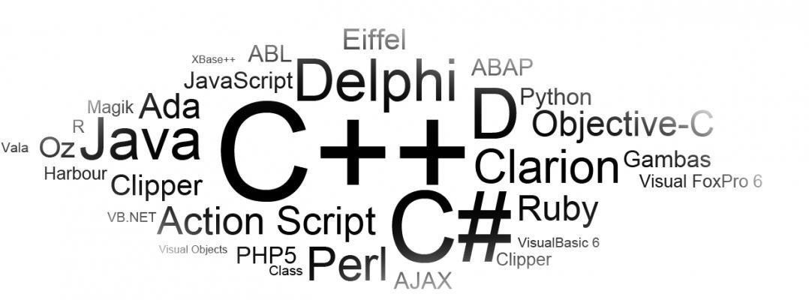
Introduction
A number of OOP languages are available today with some differences between their capabilities and the extent to which they in accordance with to the OO paradigm.
Notes:
Programming paradigm based on objects (data + behavior)
Objects represent real-world entities
Example: Car → Object
Attributes: color, model, speed
Methods: start(), stop(), accelerate()

Slide 5
Some Features of Object-Oriented Programming
Strong typing
The degree of discipline that a language enforces
on the programmer when declaring variables.
“Every data value and object that is used must belong to an appropriate type for its context”.
Most modern languages are strongly typed.
int x = "Hello"; // Compile-time error in Java
Prevents type mismatch errors
Reduces runtime bugs

Slide 6
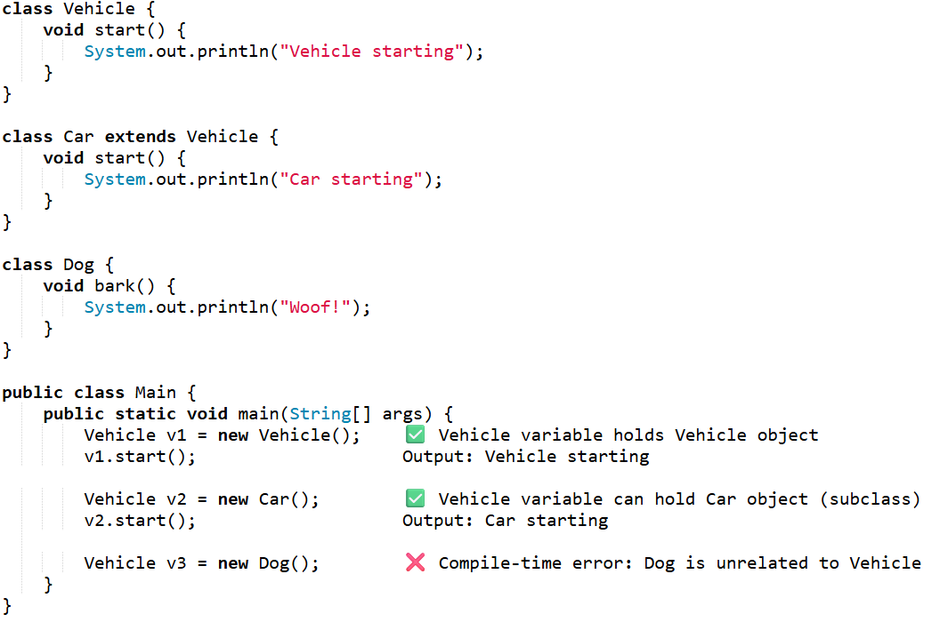
Some Features of Object-Oriented Programming

Slide 7
Some Features of Object-Oriented Programming
Static/ Dynamic typing
Static typed: Check types at compile time.
Dynamic type : Check types at run time.
Some languages offer a hybrid approach.
Examples of Languages:
Static: Java, C++, C#
Dynamic: Python, Ruby, JavaScript
Hybrid: TypeScript, Kotlin

Slide 8
Some Features of Object-Oriented Programming
Static/ Dynamic typing
Typing | Advantages | Disadvantages
Static | Errors caught at compile time, better performance, easier IDE support | Less flexible, verbose code
Dynamic | Flexible, faster to write, less verbose | Errors occur at runtime, harder to debug, slower performance

Slide 9
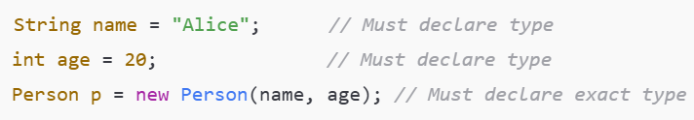

Some Features of Object-Oriented Programming
Static/ Dynamic typing
Static Typed (Java) – Verbose
Dynamic Typed (Python) – Less Verbose
Notes:
“Verbose code” simply means writing more lines of code or more detailed code to achieve something.

Slide 10

Garbage Collection
Important for memory management in systems that create & delete many objects during their execution.
Objects are removed from memory when they are deleted (otherwise the system may run out of memory
in which to execute).
.
Example problem without GC:
Notes:
Automatic process of freeing memory occupied by objects that are no longer used by the program.
Helps prevent memory leaks and out-of-memory errors in long-running programs.
In Java, objects are stored in heap memory

Slide 11


Types of Garbage Objects in Java
.
Nullified Objects
Out of Scope Objects
Notes:
Automatic process of freeing memory occupied by objects that are no longer used by the program.
Helps prevent memory leaks and out-of-memory errors in long-running programs.

Slide 12
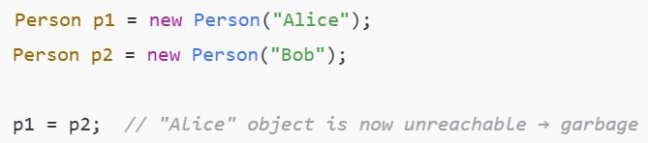
Types of Garbage Objects in Java
.
Unreachable Objects via Reassignment
Notes:
Automatic process of freeing memory occupied by objects that are no longer used by the program.
Helps prevent memory leaks and out-of-memory errors in long-running programs.

Slide 13
Standardized class libraries
A standardized class library is a collection of predefined classes and interfaces provided by the language so programmers can reuse tested code instead of writing everything from scratch.
Key Features:
  Cross-platform compatibility
  Pre-tested and reliable
Dynamic Loading
Dynamic loading is the ability of a program to load classes or libraries into memory at runtime, rather than at compile time.
Notes:
Key Features
Cross-platform compatibility: Works on any OS where Java runs
Pre-tested and reliable: Reduces errors and development time
Object-Oriented: Libraries provide ready-to-use classes, objects, and methods
Consistent naming and usage conventions across libraries
Classes are loaded only when needed, improving memory usage and flexibility.

Slide 14
Limitations of Object Orientation

Slide 15
Applications Which are Not Ideally Suited to OO Development
Systems that are strongly database oriented
  Systems which have a record based structure of data that is appropriate to a Relational Database Management System (RDBMS).
  Also that their main processing requirement center on the storage and retrieval of the data.
Notes:
Systems where the main operations are CRUD (Create, Read, Update, Delete) on structured records
Relational Database Management Systems (RDBMS) are often more natural for these applications
OO approach may add extra overhead for mapping objects to tables (e.g., using ORM frameworks)
Example: Banking system or accounting software where most operations are database transactions

Slide 16
Applications Which are Not Ideally Suited to OO Development
Applications that are strongly algorithmic in their operation
  Some scientific applications that involve large & complex calculations may be neither desirable nor
feasible to split the calculation down into smaller parts.
  If such a system is implemented by OOP there might be more objects and they will be very complex.
  Ex: Satellite orbit calculations
Notes:
Applications with complex mathematical or scientific calculations
Splitting calculations into objects may increase complexity and reduce performance
OO design might result in many small objects with unnecessary overhead
Example: Satellite orbit calculations, numerical simulations, weather prediction models

Slide 17
Exercise
In what scenarios might Object-Oriented (OO) development not be the best choice, and what are the limitations or mismatches with the nature of the problem being solved that contribute to this?

Slide 18
THANK YOU!

